Slide 1
Lesson 20: Process Characteristics- 2nd Order Lag Process
ET 438a Automatic Control Systems Technology

Slide 2
Learning Objectives
After this series of presentations you will be able to:
Describe typical 2nd order lag models found in control systems.
Write mathematical formulas for 2nd order lag process models
Compute the parameters of this process model.
Identify the Bode plots of this process model.
Identify the time response of this process model.

Slide 3
Second-Order Lag Processes
Characteristics: Two energy storage elements
System response determined by three parameters: steady-state gain-G, damping ratio ζ, and resonant frequency, ω_{o}
Examples: 2 capacitances,
1 mass and 1 spring
1 capacitance and 1 inductance

Slide 4
General Second Order Lag Process Equations
Time domain equation:
Transfer function:
Parameters in terms of
coefficients A₁ and A₂
Coefficients in terms of
Parameters ζ and ω₀

Slide 5
General Second Order Lag Process Equations
Combine these
two equation
and simplify
Characteristic Equation: Roots determine system response

Slide 6
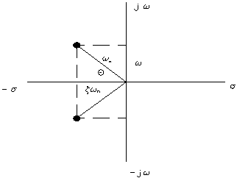
Second Order System Responses
Find roots to characteristic equation
Two poles at these
locations
Plot these roots on complex plane
As poles near imaginary axis
system become
more oscillatory
If ζ=0, damping is zero and system will oscillate at ω=ω₀

Slide 7
Second Order System Responses
ω₀ζ=σ
This controls the exponential rise and decay
When 0<ζ<1 above equation determines conditional frequency-a damped sinusoid

Slide 8
Second Order System Responses
Roots of quadratic formula can have three possible forms
1) real - distinct
2) real - identical
3) imaginary - conjugate pairs
jω
Location of roots is controlled by the values of ζ and ω₀.
If natural frequency is constant them damping controls system response
−σ
σ
-jω

Slide 9
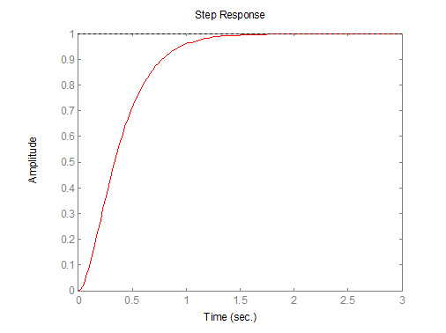
Second Order System Responses
Damping coefficient value and system responses
ζ = 1 - critically damped system. Reaches the final value the fastest without having any overshoot. Roots are equal and real.
Time response
Final value in approx. 1.4 seconds No Overshoot.

Slide 10
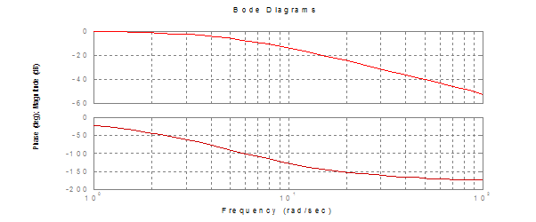
Second Order System Responses-Critically Damped
Bode plot of Critically damped system
Two poles at this point -3 dB from max. gain
Response
similar to
lag process

Slide 11
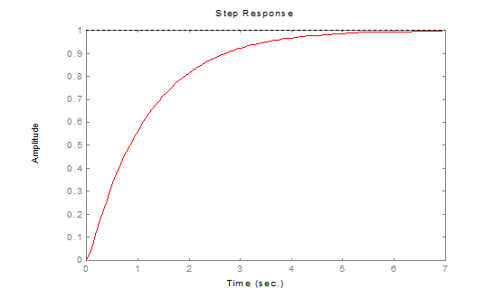
Second Order Response-Over Damped System
ζ > 1 - over damped system. Reaches the final value slowly but with no overshoot. More damping, slower response to final value. Roots are real but not equal.
Compared to the critically damped case, the response time is slower. Approx. 6.5 sec to get to final value vs 1.4 sec
6.5 sec

Slide 12
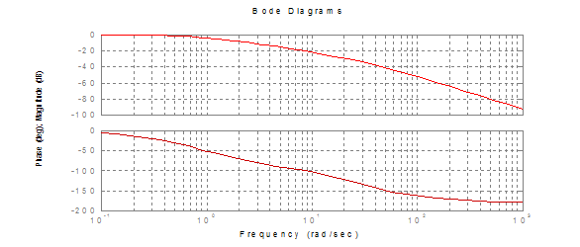
Over Damped System Frequency Response
Bode plot of Over damped system
Pole at this point -3 dB from max. gain
Second Pole at higher frequency

Slide 13
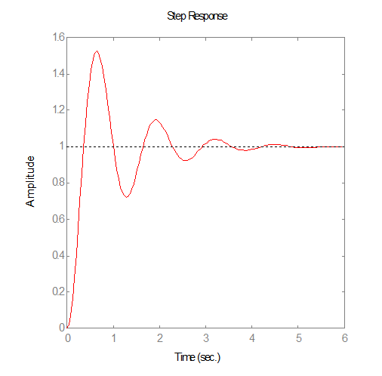
Second Order Response-Under Damped System
ζ < 1 - under damped system . Reaches the final value fast but with overshoot. Less damping more overshoot. Roots are conjugate pairs.
Overshoots to 1.5
Settling time is time
Required to reach
% of final value
Approximately 4.5 sec

Slide 14
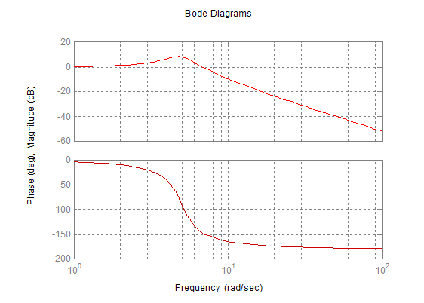
Under Damped System Frequency Response
Bode plot of under damped system
Resonant Peak at 5 rad/sec
Natural oscillating
frequency of system
90 degree phase
shift at resonant
frequency

Slide 15
Determining System Parameters From Characteristic Equation
Example 18-5: The block diagrams shown below represent three second order systems. Use the characteristic equations of each transfer function to determine the values of ω₀ and ζ for each and determine if each system is over, under or critically damped.
a)
X(s)
Y(s)
b)
X(s)
Y(s)
c)
X(s)
Y(s)

Slide 16
Example 18-5 Solution (1)
a) Equate the general characteristic equation with that of the transfer function.
Equate Coefficients
Ans
Ans
Critically damped
b)
Ans
Ans
Over damped

Slide 17
Example 18-5 Solution (2)
c)
Ans
Ans
Under damped
Note: The numerator of the transfer functions does not affect the response of the system. It determines the maximum output.
As damping increases, one of the system poles becomes more dominant. The dominant pole controls system response.

Slide 18
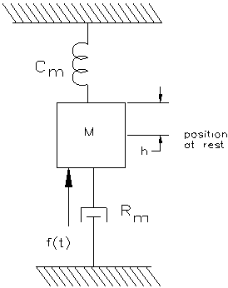
Second Order Mechanical System
Example 18-6: The mechanical system shown below is at rest with an initial height of h(0)=0. An external input force, f(t) disturbs the system. The system output , h(t) is the centerline position of the mass. The system parameters are:
C_{m} = spring capacitance (Inverse of spring constant, K) =0.001 m/N
R_{m} = resistance due to viscous friction (B)= 20 N-s/m
M = mass = 10 Kg
Find: a) coefficients of the second order system equation
b) system transfer function
c) resonant frequency
d) damping ratio
e) if system is over, under or critically damped

Slide 19
Example 18-6 Solution (1)
a) Sum the external forces. From Newton’s Law F=Ma
Sum forces
f_{s}(t)
Ma
Where:
M
+
f(t)
f_{d}(t)

Slide 20
Example 18-6 Solution (2)
Add terms to both sides
General form of 2nd order
system
Ans a

Slide 21
Example 18-6 Solution (2)
b) Find transfer function
F(s)
s²H(s)
sH(s)
Take Laplace transform of above equation and factor out common term
Ans

Slide 22
Example 18-6 Solution (3)
c) Find the resonant frequency ω₀
Ans
d) Find the damping ratio ζ
Ans
The damping ratio is ζ<1, so the system is under damped. Applying external force causes the mass center to oscillate before coming to rest at a new position.

Slide 23
End Lesson 20: Process Characteristics-2nd Order Process
ET 438a Automatic Control Systems Technology

